Slide 1
Massport Community Advisory Committee (MCAC) - General Committee Meeting
Presented to: MCAC General Committee
Date: September 18, 2025
Elisabeth Smeda, Deputy Regional Administrator (A), FAA New England Region

Slide 2
Agenda
Block 1 & 2
Aviation Noise Advisory Committee Status
Noise Policy Review Status and
RNP 33L Utilization

Slide 3
FAA Status Update – 9/18/2025
Block 1--Complete
Block 2
Runway 22 L/R RNAV SID:
  New departure procedure modifies existing RNAV straight-in departure (SID) from runway 22L/R with speed restrictions enabling aircraft departing from BOS an earlier turn to East, resulting in shifting flight paths north and away from Hull.
  Published Nov 30, 2023 (complete)
Runway 22L RNAV approach:
  This approach crosses the Nahant Causeway from the East to join a 4-mile final to Runway 22L. Testing was completed to collect accurate data regarding noise complaints, weather, runway usage and radar flight tracks affected by this approach. Noise measurements and report findings were collected by MIT and provided to MCAC for review.
  Published Nov 30, 2023 (complete)

Slide 4
Aircraft Noise Advisory Committee (ANAC) Status
    The Aircraft Noise Advisory Committee (ANAC) charter was amended on June 9, 2025, and will expire on January 14, 2027.
    FAA will issue a Federal Register Notice soliciting members for the committee. The committee will have no more than 24 members representing engine manufacturers, air carriers, airport owners or operators, aircraft manufacturers, advanced air mobility manufacturers or operators, institutions of higher education, and representatives of airport-adjacent communities from geographically diverse regions.
    FAA encourages individuals that are interested in membership on ANAC to respond to the solicitation notice once it is published.

Slide 5
Noise Policy Review (NRP)
Link on FAA website for a comment summary of overarching themes, feedback, and recommendations during public comment period: www.faa.gov/noisepolicyreview/summary-of-comments
ANAC must be formed, then submit its report, after which we should have more information on the timeline for completing the Noise Policy Review.
ANAC may recommend policy changes.

Slide 6
RNP Approach Utilization
Required Navigation Performance (RNP) approach was made available starting December 30, 2021.
The Operations and Airspace Analytics (IOAA) tool was used to track usage between December 30, 2021, and June 30, 2025 (12am – 5am ET).
Flights using RNP approach were identified using surveillance (ADS-B + radar) data.
Note: Runway 33L was closed from August 14 – November 22, 2023.

Slide 7
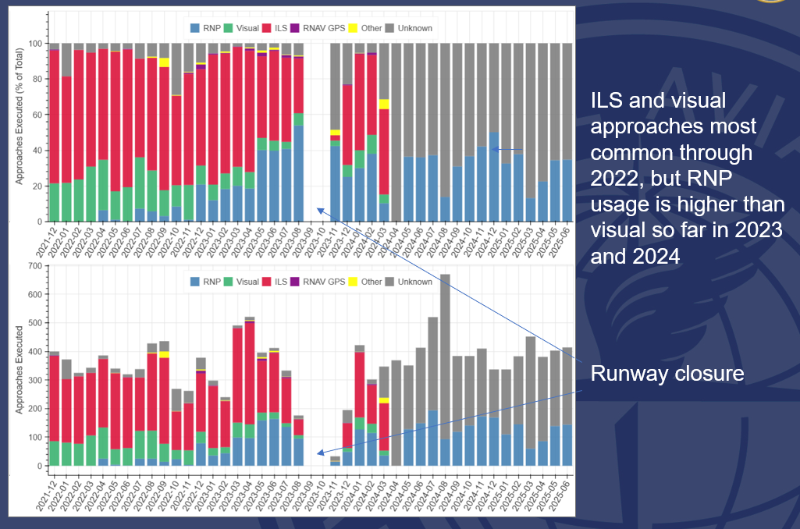
BOS 33L Approach Breakdown by Month (12 AM – 5 AM)
Percentage
RNP approaches identified using surveillance data
Non-RNP approach type derived from pilot-controller voice data at Boston TRACON
  Voice data incomplete for October 2022, November-December 2023, 2024
  No new voice data received after March 2024
Counts

Slide 8
Summary
RNP X-ray usage to runway 33L continues on upward trend in the overnight period
  Implemented December 2021, but not used initially
  Starting in April 2022, advertised on ATIS; first usage was ad-hoc through 2022
  Starting in December 2022, has become the default expectation from Boston Air Traffic Control
Usage depends on weather conditions, aircraft and flight crew capability, and interactions with other aircraft in sequence
FAA has increased usage in the overnight period by advertising the RNP approach on the ATIS and telling arrivals to “expect” it upon initial check-in with the TRACON

