Slide 1
Massport Community Advisory Committee
General Meeting
MCAC Members
Marie Kennington-Gardiner June 18, 2026

Slide 2
AGENDA
Aircraft Noise Advisory Committee
Noise Policy Review Update
RNAV (RNP) X RWY 33L Approach Usage
RNAV (GPS) Y RWY 22L Usage
RNAV (GPS) RWY 22L/22R Departure SIDs Usage

Slide 3
Aircraft Noise Advisory Committee (ANAC)
          The FAA Reauthorization Act required FAA to form the Aircraft Noise Advisory Committee (ANAC) to advise FAA on issues related to aircraft noise exposure and existing FAA noise policies and regulations.
            According to the ANAC Charter, the Committee is responsible for:
              Evaluating existing research on aircraft noise impacts and annoyance
              Assessing alternative noise metrics that could be used to supplement, modify, or replace the existing Day Night Level standard, in consultation with the National Academies
              Evaluating the current 65-decibel exposure threshold, including the impact to land use compatibility around airports if such threshold was lowered
              Evaluating current noise mitigation strategies and the community engagement efforts by the FAA with respect to changes in airspace utilization, such as the integration of new entrants and usage of performance-based navigation
              Other duties as assigned by the FAA Administrator.

Slide 4
ANAC STATUS
FAA will issue a Federal Register Notice soliciting members for the committee. The committee will have members representing the following:
Engine manufacturers
Air carriers
Airport owners or operators
Aircraft manufacturers
Advanced air mobility manufacturers or operators
Institutions of higher education
Representatives of airport-adjacent communities from geographically diverse regions.

Slide 5
NOISE POLICY REVIEW UPDATE
The FAA completed its review of the 4,857 comments received after the Noise Policy Review Federal Register Notice and has developed a summary of comments:
https://www.faa.gov/noisepolicyreview/summary-of-comments
The comments will help inform the work of the ANAC.
FAA will complete the Noise Policy Review once the ANAC has submitted a report to the FAA with any recommended policy changes.

Slide 6
RNAV (RNP) X RWY 33L Approach
The RNP approach was made available starting December 30, 2021.
The Performance Data Analysis and Reporting System (PDARS) was used to track usage between May 1, 2025 – April 30, 2026 (12am – 5am ET)
Flights using the RNP approach were identified using FAA-official surveillance data.
The RNP approach was made available starting December 30, 2021
The Performance Data Analysis and Reporting System (PDARS) was used to track usage between May 1, 2025 – April 30, 2026 (12am – 5am ET)
Flights using the RNP approach were identified using surveillance data.
Notes:
We are using PDARS because FAA is the official source of radar surveillance track data. MITRE’s IOAA tool is derived indirectly from the surveillance sources called “threaded tracks.” The IOAA tool is good, but can be 6 months behind (has an issue with currency). The FAA defines surveillance data as the real-time position, identity, and altitude of aircraft within the National Airspace System (NAS). This data is used by air traffic controllers to safely separate aircraft, vector flights, monitor approaches, and provide weather and traffic information.

Slide 7
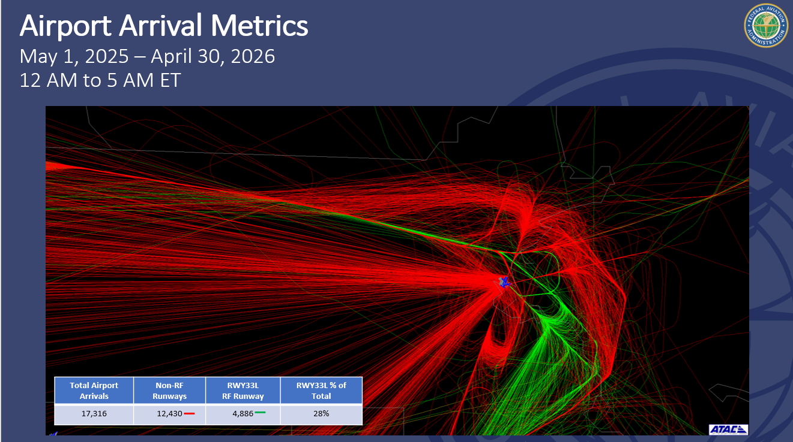
Notes:
Midnight shift adjusted for daylight savings time (standard and DST). 4,886 total arrivals to 33L, which includes the RNAV RNP 33L and any other approach. Out of that total, 4,594 arrivals were equipped for an RNP, which is 94% of all runway arrivals. Of those equipped,

Slide 8
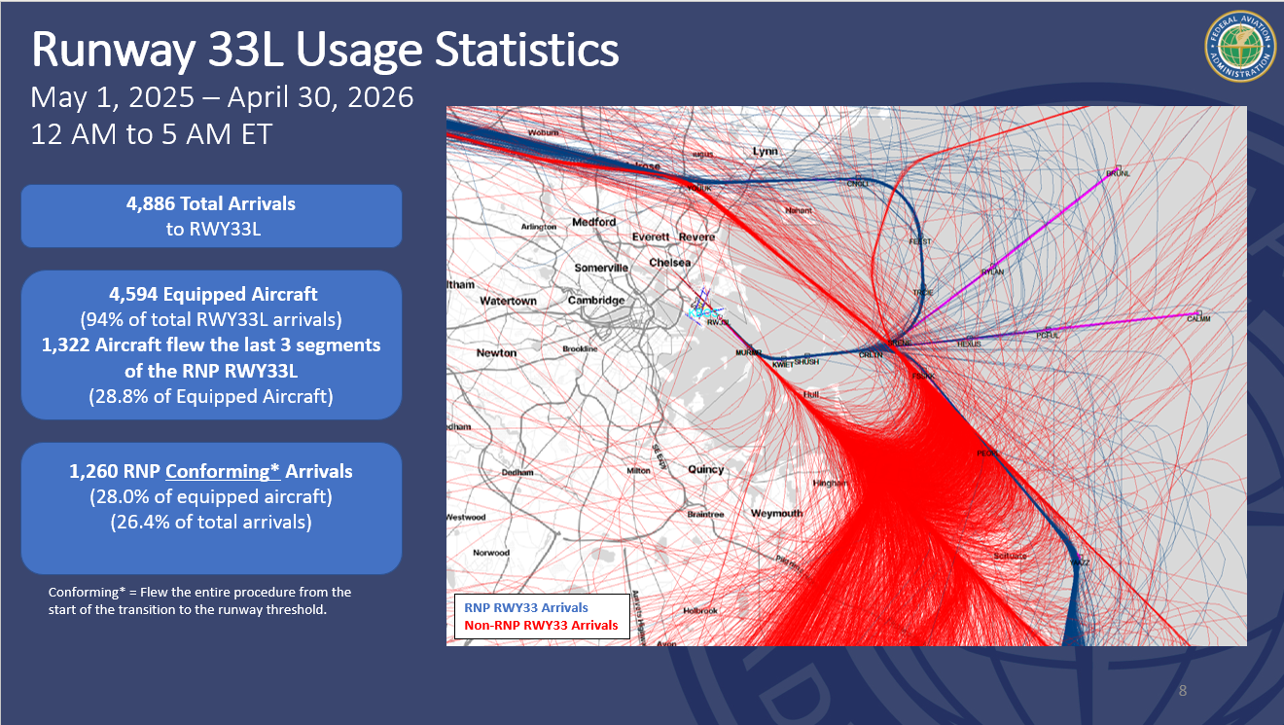
Notes:
Midnight shift adjusted for daylight savings time (standard and DST). 4,886 total arrivals to 33L, which includes the RNAV RNP 33L and any other approach. Out of that total, 4,594 arrivals were equipped for an RNP, which is 94% of all runway arrivals. Of those equipped, 1,322 flew at least SHUSH inbound. Because flying an approach can be defined differently, we are defining it as flying the entire approach, from the start of one of the four transitions (YUK, BRUNL—all meet at CRLTN. The 1,260 out of 1,322 flew the entire approach (i.e., conforming) based on conformance reports. The 1,260 out of total arrivals to RWY 33L—including visual and ILSs—was 26.4%. So, 95.3% out of the total that flew the approach were conforming (1,260 out of 1,322). The IOAA tool (MITRE), used previously, is different but it

Slide 9
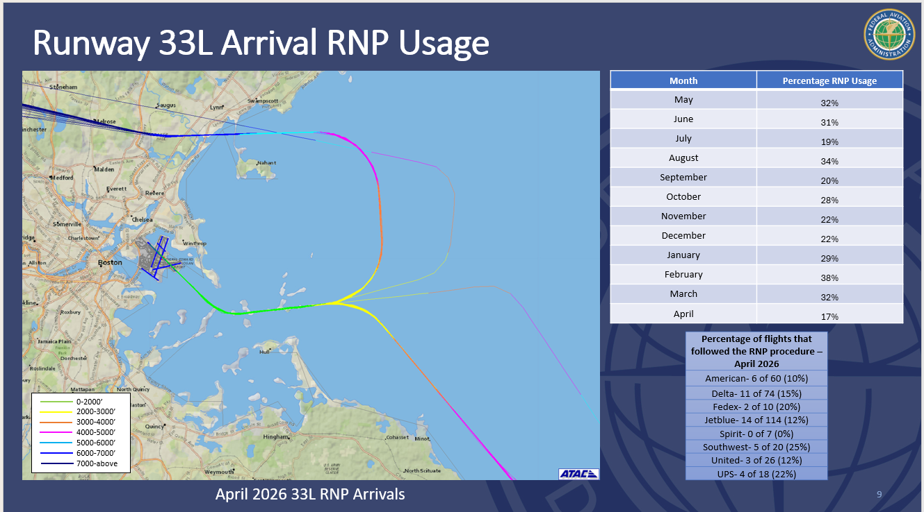
Notes:
This was in the former presentation. The image shows the activity during the month of April 2026. RNP usage by month is shown on the right. Color-coded altitudes by strata so you can see where the flights are descending. Yellow and green is 3,000 ft and below. The percentage of flights that followed the RNP procedure during the month of April by the major airlines is on the bottom right.

Slide 10
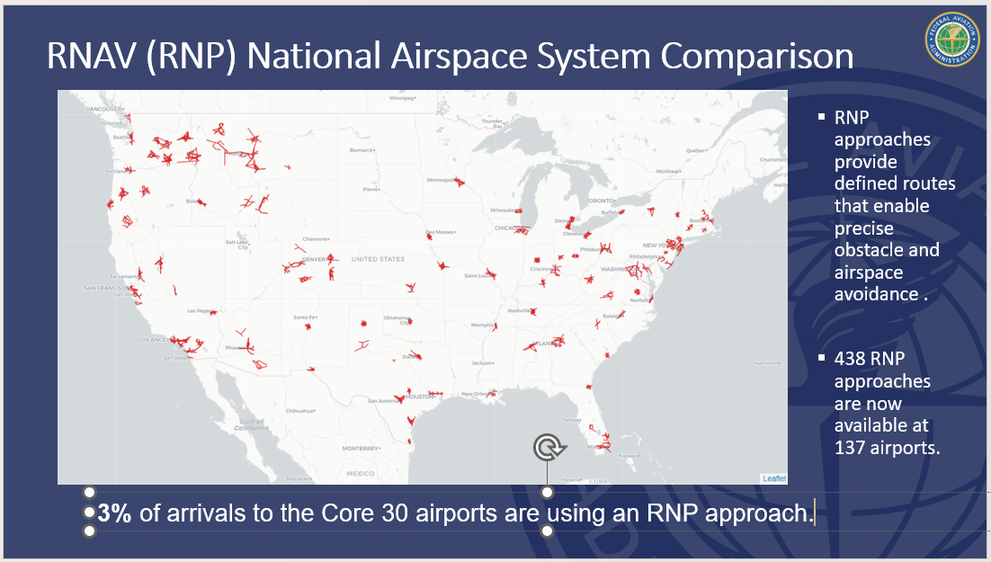

Slide 11
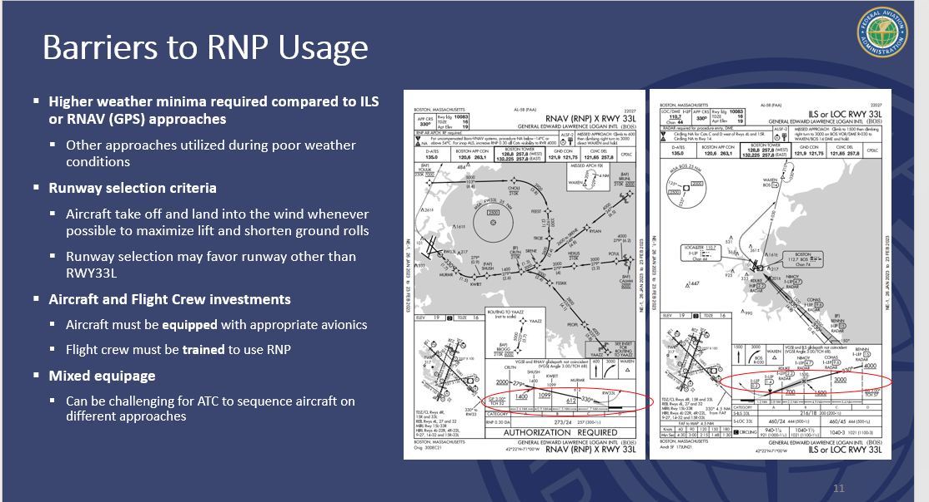
Notes:
This information shows that it is challenging for controllers to merge and sequence other approaches with an RNP approach because an RNP locks an airplane on a fixed route and doesn’t give the controller flexibility to move those airplanes unless the remove them off of it. Controllers when they assign an RNP are urged not to take them off (unless safety or sequency issue) because they went to the trouble of putting them on the approach, controllers will try their best to keep them on it. It’s a challenge south on an ILS approach it’s a challenge to hit those gaps to create holes in the string of aircraft on the RNP. This explains why it is only 27%.

Slide 12
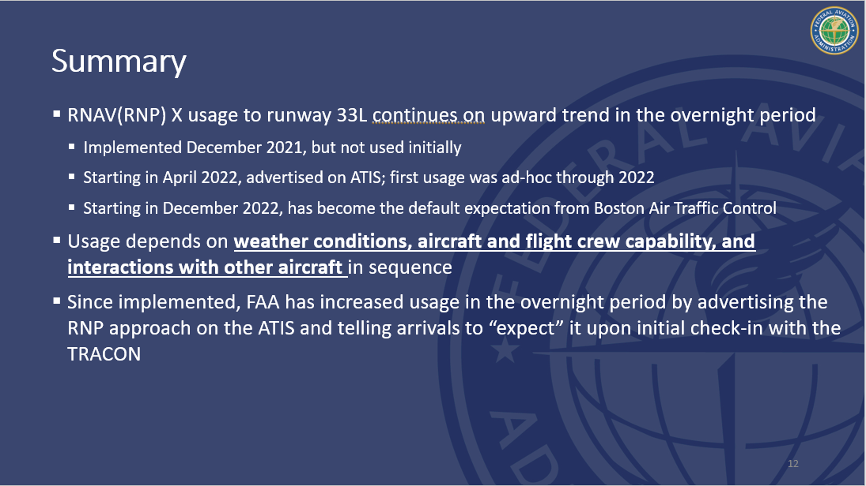
Notes:
ATIS is a radio broadcast that is sent out over the air 24/7 on a loop. Controller may still vector the aircraft and pilots can say they cannot accept that approach. But, ATIS gives the pilot a heads. Last bullet: there has been a percentage change from 20.6% conforming arrivals to 26.4% since prior reporting to the MCAC.

Slide 13
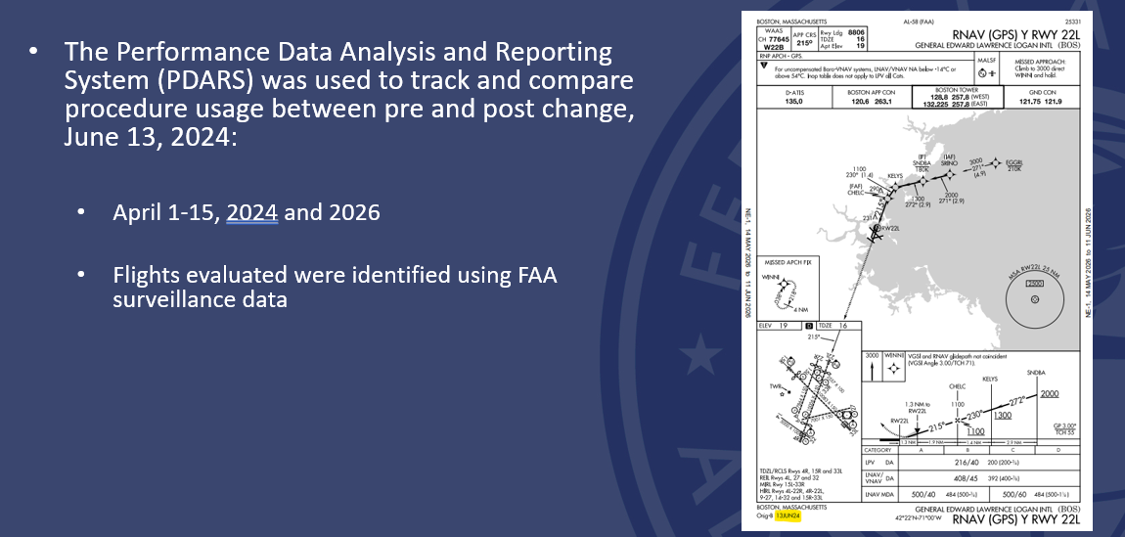
RNAV (GPS) Y RWY 22L Utilization
Notes:
Pre and post change. April 2024 (not flown at all) and April 2026. Approach of latest change shown with date highlighted. The two time periods analyzed were 15 days in April 2024 and the same April days in 2026.

Slide 14
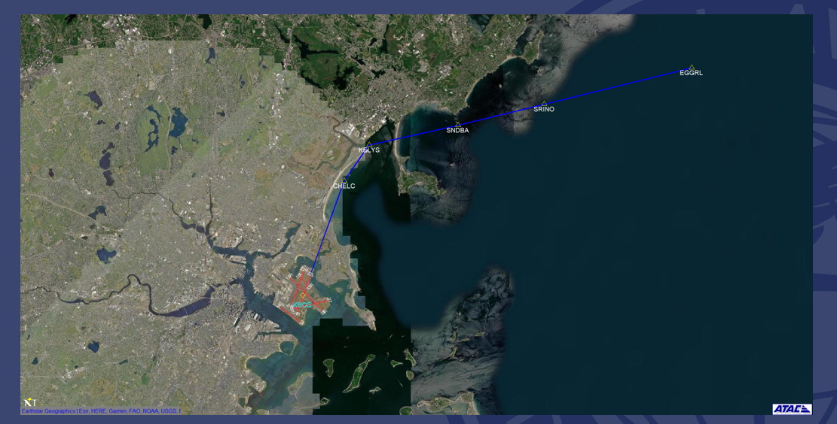
Current RNAV (GPS) Y RWY 22L
Notes:
Snapshot shows over-water approach for 15 days in April 2024.

Slide 15
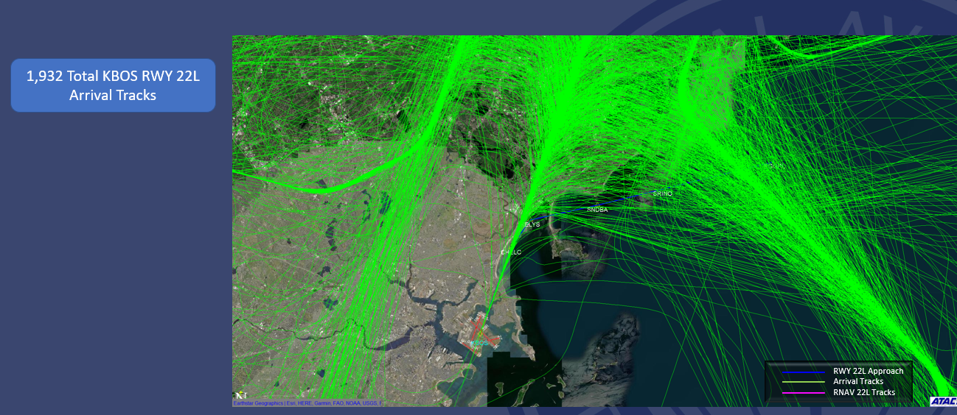
2024 RNAV (GPS) Y RWY 22L Usage
Notes:
This shows that there were no tracks (no blue lines) showing they did not fly it at all in 2024.

Slide 16
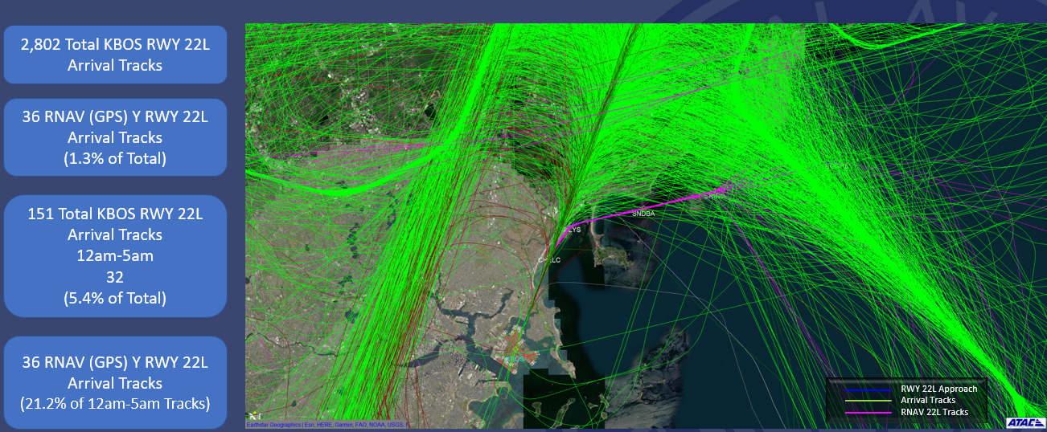
2026 RNAV (GPS) Y RWY 22L Usage
Notes:
Same view shown over 15 days in April 2026. There were 2,802 arrivals during those days. Only used 1.3% of the time; however, it is being used. In order to get aircraft over to the RNAV procedure, ATC has to vector aircraft way out over the ocean, which adds flying miles/time. to get them onto the 22L approach. Typically, they want to get them on the downwind and take them where appropriate and get them in sequence and turn them on the straight in localizer (which saves a lot of flying miles). Sequence is then close to the airport, and challenging to use new procedure at merge point. However, used mostly by the TRACON between 10pm and 6am to reduce noise impacts.

Slide 17
RNAV (GPS) Y RWY 22L Usage Summary
BOS TRACON completed training controllers and implemented the new procedure.
Change was implemented on June 13, 2024.
Usage depends mostly on interactions with other aircraft in sequence.
Notes:
The sequencing is the most relevant factor in using RWY 22L, especially when it is busy. Tougher because the turn that pilot is flying without controller intervention is closer the airport, meaning the controller has less opportunity for the controller to sequence into other traffic. Essentially, the controller has to set the gap for the straight in (leave 6-mile “holes” so he or she can stick one of the them in the 3-mile mark). The other arrivals are already on course that a controller is not managing, so for the controller to sequence the new RWY 22L arrivals, The controller does not have all the tools so the only way he can do it is to slow the aircraft down or take him out and bring him back, which results in adding flying time and aircraft ends up pointing at other traffic. Precision on spacing for the final is key. The procedure does exist and it does reduce aircraft noise over land.

Slide 18
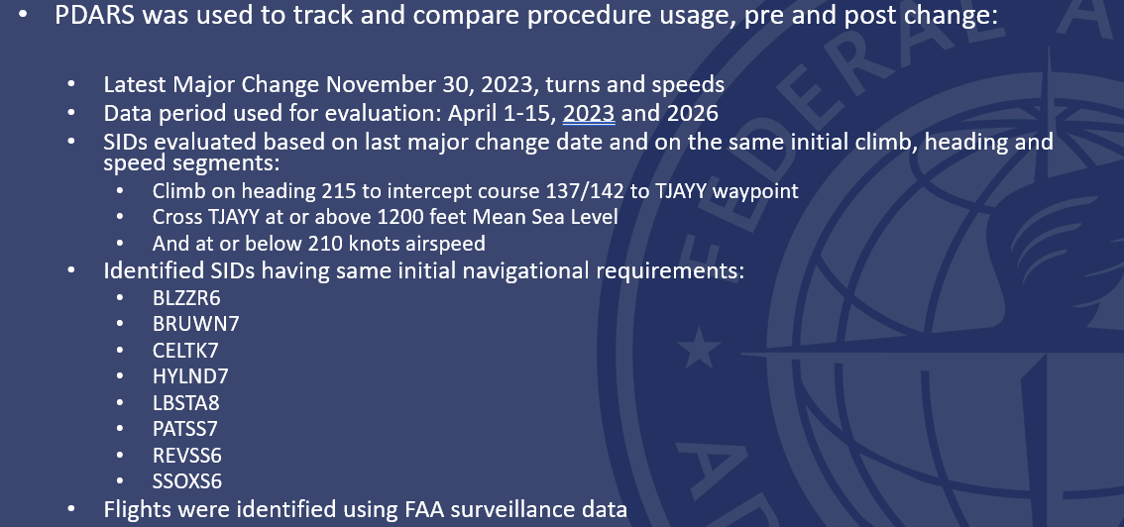
RWY 22L/R RNAV SIDs Usage (8 SIDs)
Notes:
Same time frame in April, but backed initial date by a year to capture data prior to November 30, 2023. Key to the change were the initial climb, initial heading, and speed. 8 SIDs were changed because one changed so the tower and TRACON know what is going to happen.

Slide 19
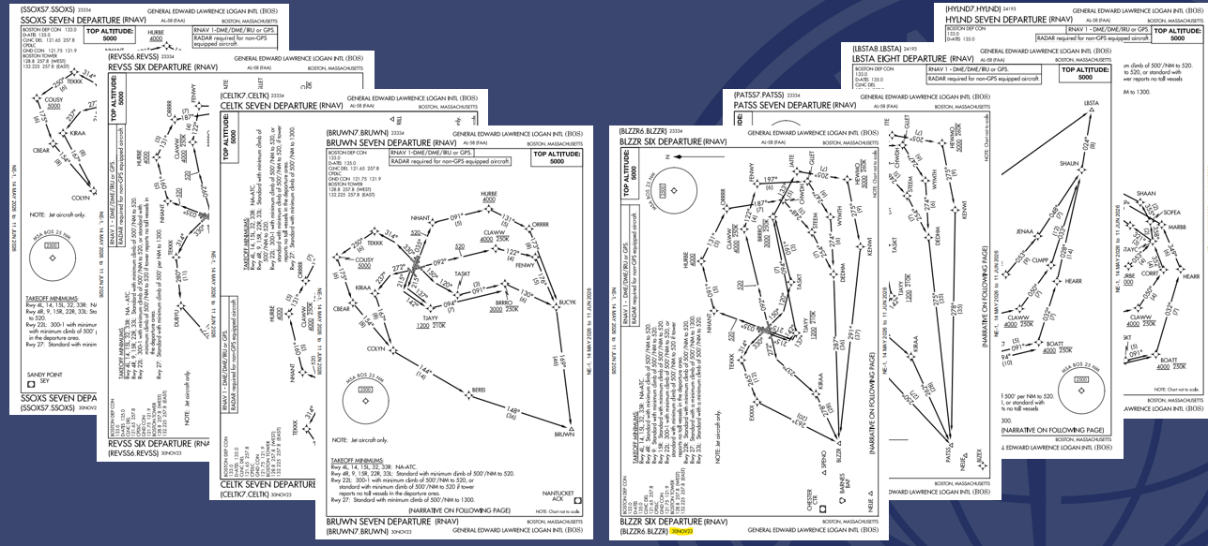
RWY 22L/R RNAV SIDs
Notes:
All 8 SIDs are represented on slides 18 and ff. When one SID changed, all 8 needed to be changed. This slide represents the 8 SIDs.

Slide 20
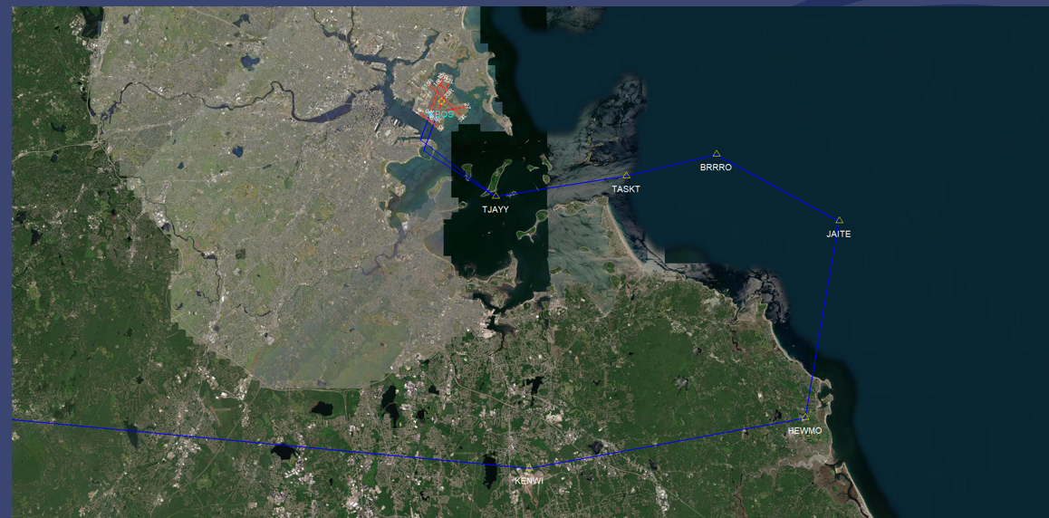
Current BLZZR6 SID RWY 22L/R Transitions
Notes:
Trying to avoid lighthouse and Hull

Slide 21
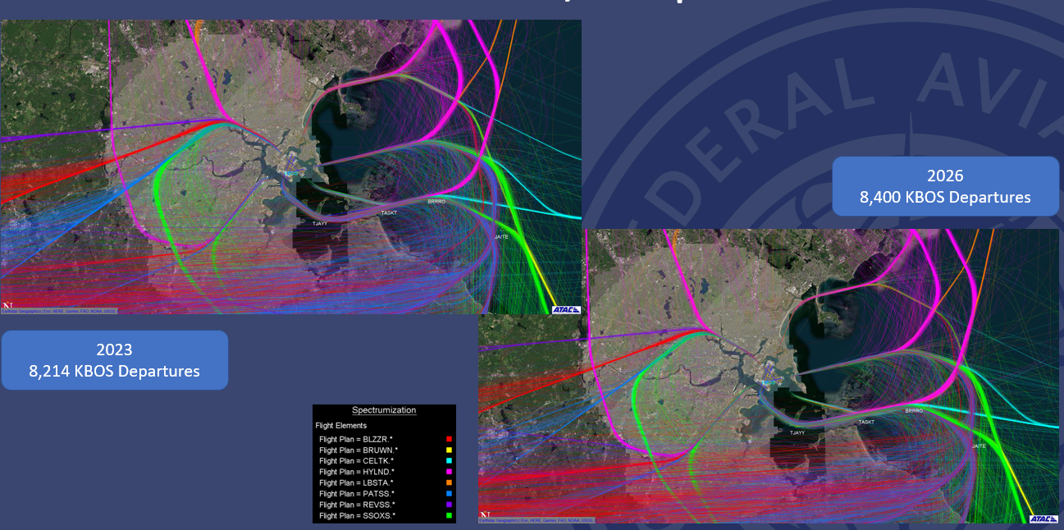
Total BOS RWY 22L/R Departures
Notes:
For these two time periods, the 8 SIDs go off all directions. Wind is going to factor into usage. In 2023 there were 8,214 departures and in 2026 there were 8,400 departures.

Slide 22
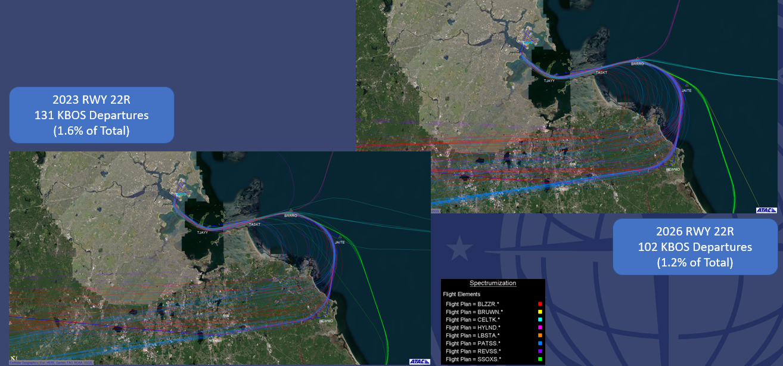
RWY 22R BOS Departures
Notes:
For RWY 22R, overall, the usage dropped from 1.6% in 2023 to 1.2% in 2026; however, it is being used.

Slide 23
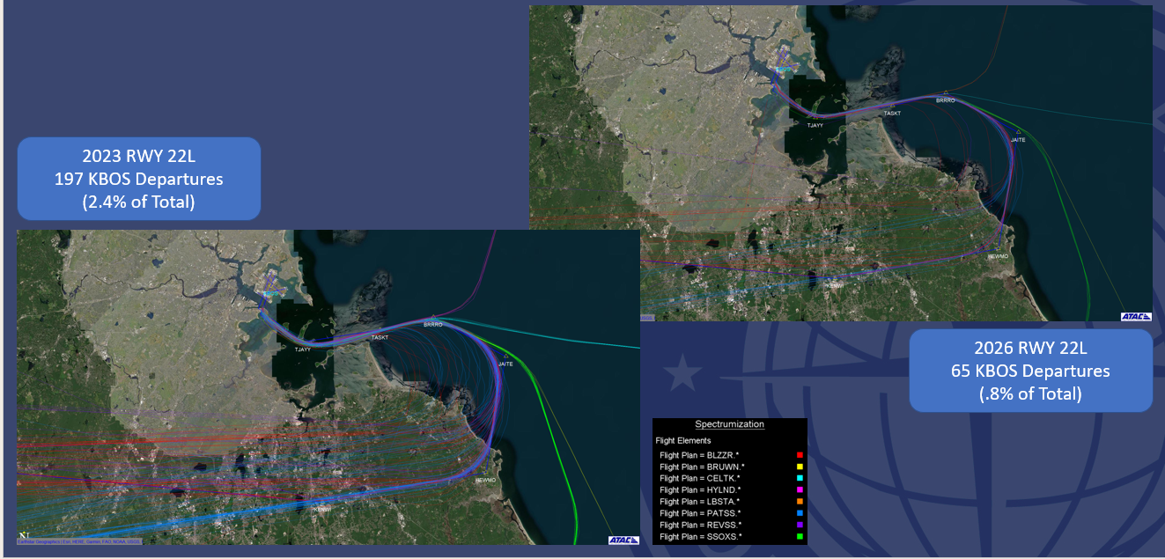
RWY 22L BOS Departures
Notes:
For RWY 22L. The percentage also dropped.

Slide 24
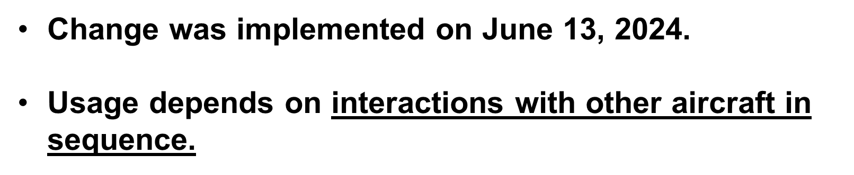

RWY 22L/R RNAV SIDs Summary
Notes:
SAME NOTE AS IN SLIDE 17: The sequencing is the most relevant factor, especially when it is busy. The controller does not have all the tools so the only way he can do it is to slow the aircraft down or take him out and bring him back, which results in adding flying time and aircraft ends up pointing at other traffic. Precision on spacing for the final is key. The good news is that this procedure does exist and it does reduce aircraft noise over land.

